Slide 1

Baker Hughes México Data Science Hackathon 2022
Predicting modeling Challenge
Predictive team A

Slide 2
Executive summary
Exploratory data analysis
Model selection by Root Mean Square Mean
Linear regression model
Model behaviour as expected
Assumptions of variables made with the linear regression model.
Code & Results

Slide 3
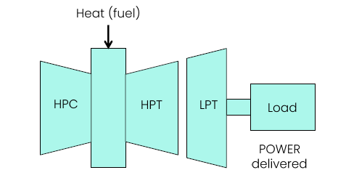
Problem description
In this competition we had to be able to develop a model for an Aeroderivative Gas Turbine to predict the POWER (kW) output from the Low Pressure Turbine (LPT).
For this porpoise we handled synthetic data that simulates the behavior of Gas Turbine engines based at different locations worldwide.

Slide 4
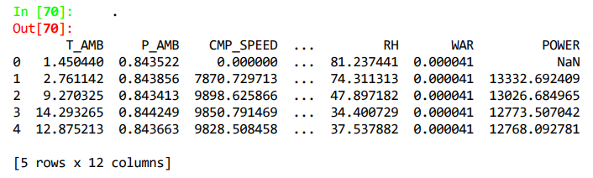
Exploratory data analysis
General data overview
Unusual 0 values
NaN values
First, we guest it was a sensor’s problem.
Then we realize that the zeros correspond to the variable CMP_SPEED and the NaN values where allocated to the turbine’s variables.
Showing that in those days the turbine was put-off

Slide 5
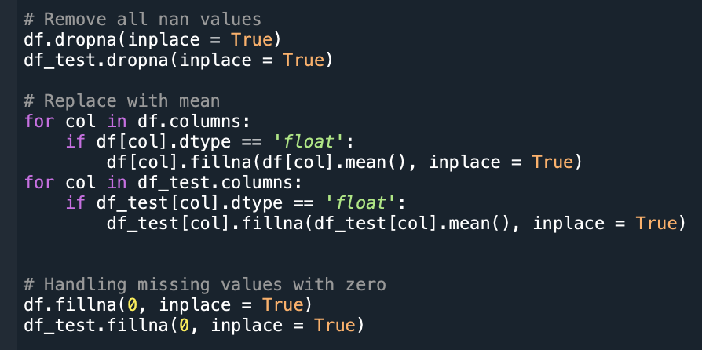
Data preprocessing and feature engineering techniques
Handling missing values
Delete the rows with missing values
Replace the missing values with the statistics mean
Replace the missing values with zeros

Slide 6
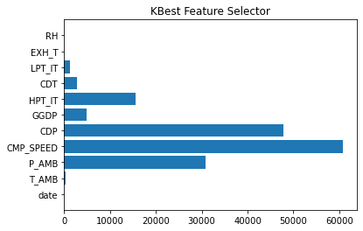
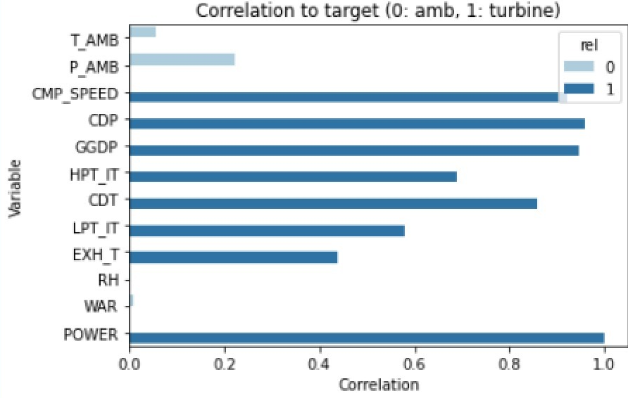
Data preprocessing and feature engineering techniques
Determinate hyperparameters.
CMP_SPEED, CDP, GGDP, HPT_IT, CDT, LPT_IT, EXH_T.

Slide 7
Selection of feature variables
CMP_SPEED, CDP, GGDP, HPT_IT, CDT, LPT_IT, EXH_T.
CMP_SPEED - compressor speed in RPM.
CDP - compressor discharge pressure, barA.
CDT - compressor discharge temperature, degC. —
GGDP - gas generator discharge pressure, barA.
HPT_IT - High Pressure Turbine (HPT) inlet temperature, degC.
LPT_IT - Low Pressure Turbine (LPT) inlet temperature, degC.
EXH_T - exhaust temperature, degC.

Slide 8
Model comparison and model selection techniques
Based in Root Mean Square Error parameters applied to the test dataset (subset).
Logistic regression
Linear regression
Ridge regression

Slide 9
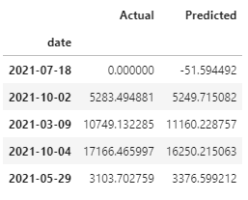
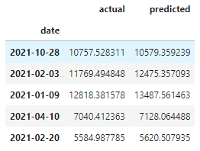
Model Selection - Linear Regression
Actual vs Predicted data on training dataset
Actual vs Predicted data on test splitted data
*Method 1

Slide 10
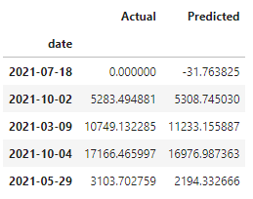
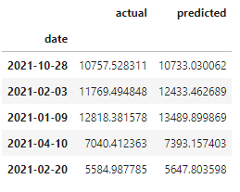
Model Selection - Linear Regression
Actual vs Predicted data on training dataset
Actual vs Predicted data on test splitted data
*Method 2

Slide 11
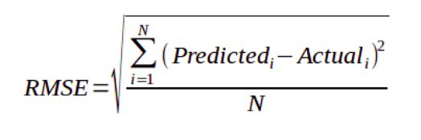
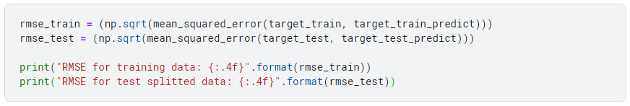


RMSE For Model Evaluation
Variables Selected by Method 1
Variables Selected by Method 2

Slide 12
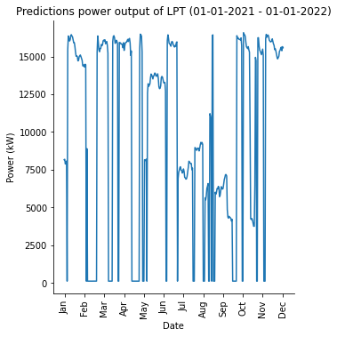
Results

Slide 13
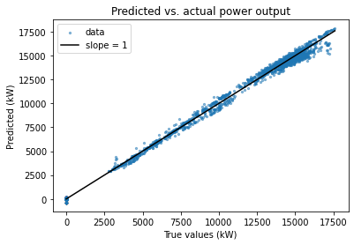
Expected vs. predictions

Slide 14
Model coefficients and model eval.
Interception → -3080.509774297314
Coefficients → -0.78558, 189.443, 3008, 260.384, -562.218, 306.611
Independent variables → CMP_SPEED, CDP, GGDP, HPT_IT, LPT_IT, EXH_T
POWER = -3080.509774297314 - 0.78558CMP_SPEED + 189.443CDP + 3008GGDP + 260.384HPT_IT - 562.218LPT_IT + 306.611EXH_T
R2: 0.9965

Slide 15
References
Pathak, M. (2018). Joining DataFrames in Pandas Tutorial. 12/03/22, de Datacamp. Sitio web: https://www.datacamp.com/community/tutorials/joining-dataframes-pandas
Ashok, P. (2020). What is ridge Regression?. 12/03/22, de Great Learning. Sitio Web: Ridge Regression Definition & Examples | What is Ridge Regression? (mygreatlearning.com)
Ohri, A. (2017). 10 Popular Regression Algorithms In Machine Learning Of 2022. 12/03/22, de Jigsaw. Sitio Web: 10 Popular Regression Algorithms In Machine Learning Of 2022 (jigsawacademy.com)
Meghna, P. (2021). Pandas dropna() - Drop Null/NA Values from DataFrame. 12/02/22, JournalDev. Sitio Web: Pandas dropna() - Drop Null/NA Values from DataFrame - JournalDev
Pandas. Versión 1.4.1. Sitio web: pandas documentation — pandas 1.4.1 documentation (pydata.org)
Scikit. Versión 1.0.2. Sitio web: scikit-learn: machine learning in Python — scikit-learn 1.0.2 documentation

Slide 16
THANK YOU!
Q&A SESSION

Slide 17
Personal experience

